Slide 1

PEG GAME GUI
Group 1

Slide 2
Overview of the peg game gui
Our Peg Game GUI has been thoughtfully designed to be both visually appealing and functional. Here's an overview of its design and features:
1. Color Scheme- The interface uses bright colors for contrast, which not only makes it visually striking but also reflects our group's favorite colors. This vibrant choice helps in enhancing user engagement by making the interface lively and inviting.
2. Layout and Structure: The GUI is structured using a BorderPane for effective layout management:
- Top Pane: At the top, we have a VBox which includes two main components:
- Heading Node: This is labeled "Play the Peg Game" and serves as the primary title for the game. It captures immediate attention and sets the context for the game.
- Game State Label: This label remains hidden until a game file is loaded. It provides real-time updates on the current game status, such as whether the game is paused or in progress, enhancing the interactive experience by keeping players informed.
3. Game Board: The center of the BorderPane is dedicated to the game board, crafted using a GridPane. This grid consists of buttons that feature graphics of circles, representing the pegs. This setup not only aligns with traditional board game aesthetics but also makes the gameplay intuitive and easy to interact with.

Slide 3
Control Panel:
- **Bottom Pane**: Occupying the bottom section is an HBox that houses four essential game control buttons:
- Load Game Button: Allows players to load a previously saved game from a file, enabling them to pick up right where they left off.
- Save Game Button* Gives players the ability to save the current configuration of the game board at any point, which is particularly useful for long playing sessions or for pausing and resuming later.
- Pause/Resume Button: This toggle button lets players pause and resume the game at their convenience. When paused, it freezes the game board to prevent any unwanted changes, thus providing a controlled gaming experience.
- Quit Button: Facilitates exiting the game at any time, ensuring that players can easily stop playing whenever they need to.
These features collectively enhance the functionality of our Peg Game GUI, making it not only a fun and engaging game but also a user-friendly and interactive tool. Each component is designed with the user's experience in mind, from the colorful visual appeal to the practical game controls.

Slide 4
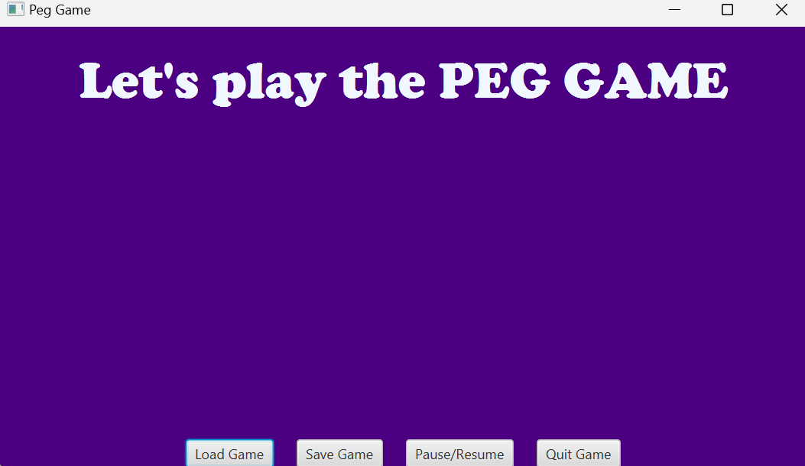
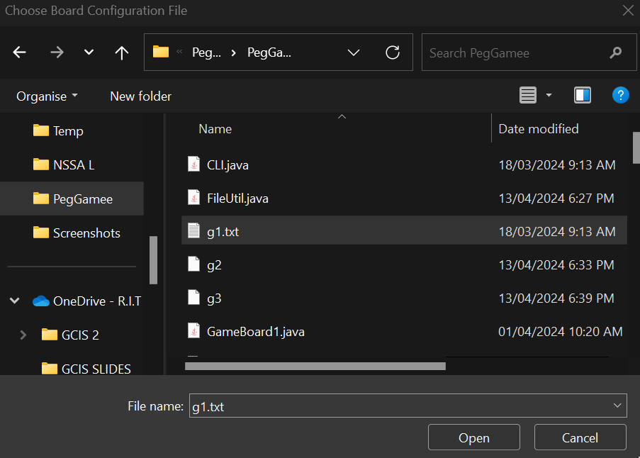
Loading the game file

Slide 5
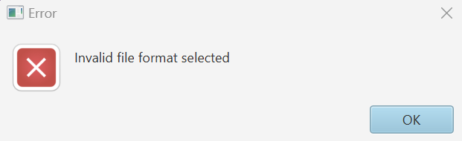
Error while loading the game file if invalid format chosen

Slide 6
ERROR HANDLING
1. **Comprehensive Error Functions**: The GUI employs two primary methods for error notification:
- **Show Error Function**: This function is specifically tailored to handle file-related issues. If there's an error while loading a game board due to an invalid file format, it promptly displays an error message. Similarly, if a game is saved in an incorrect format, this function will also trigger an error message to notify the user.
- **Alert Function**: For broader error handling, the alert function captures and displays errors through pop-up messages. This ensures that users are immediately aware of any issues.
2. **Gameplay Error Management**: During gameplay, if a player attempts to make an invalid move, the GUI responds intelligently:
- The error pop-up clearly states that the attempted move is invalid, preventing any changes to the game board configuration.
- It then advises the player to try a different move, thus maintaining the integrity of the game flow and ensuring that the player understands the correct actions to take.
3. **Immediate Notifications**: By using pop-up functions for error alerts, the GUI ensures that feedback is immediate. This approach minimizes user frustration by allowing quick correction of mistakes and helps in maintaining engagement and interest in the game.
Through these measures, our Peg Game GUI not only enhances gameplay but also educates players on proper game interaction, fostering an environment where learning and entertainment go hand in hand. This robust error handling system plays a critical role in providing a seamless and enjoyable gaming experience.

Slide 7
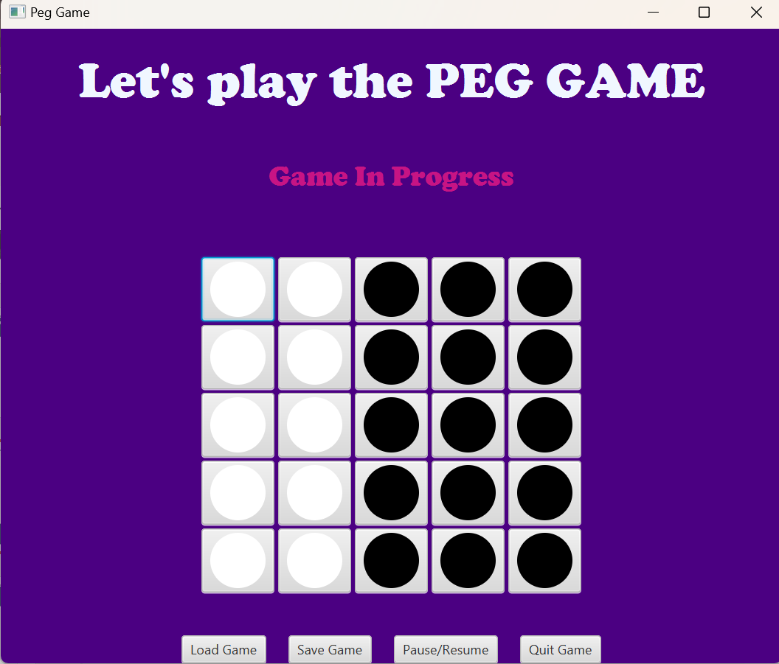
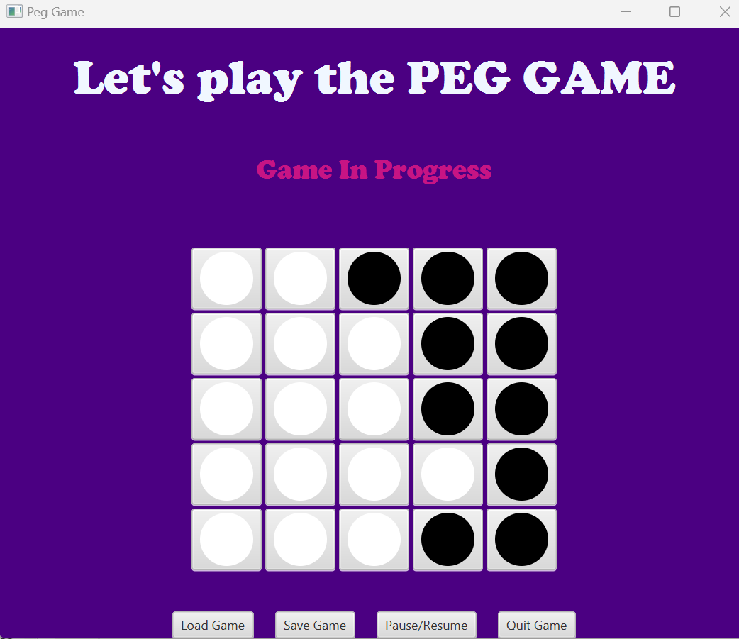
PLAYING THE PEGGAME

Slide 8
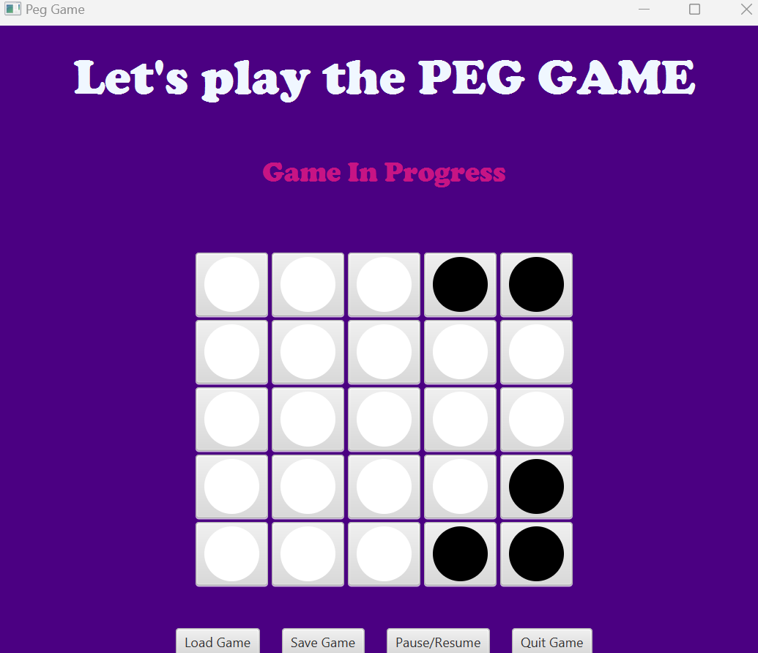
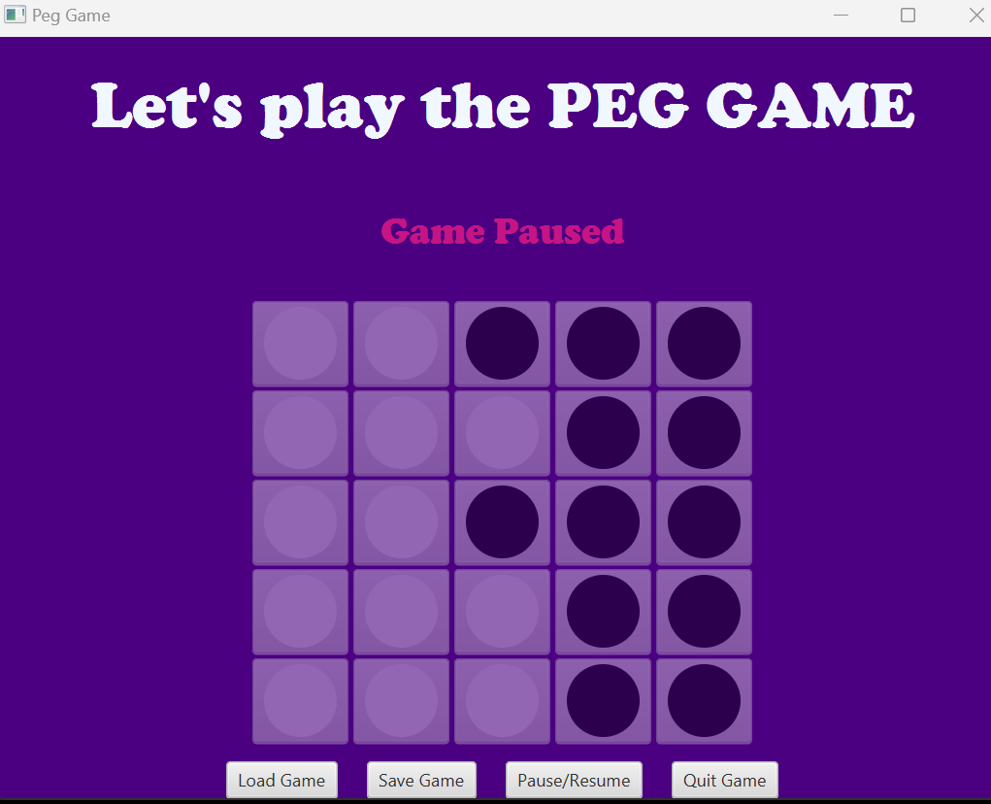
Continuation

Slide 9
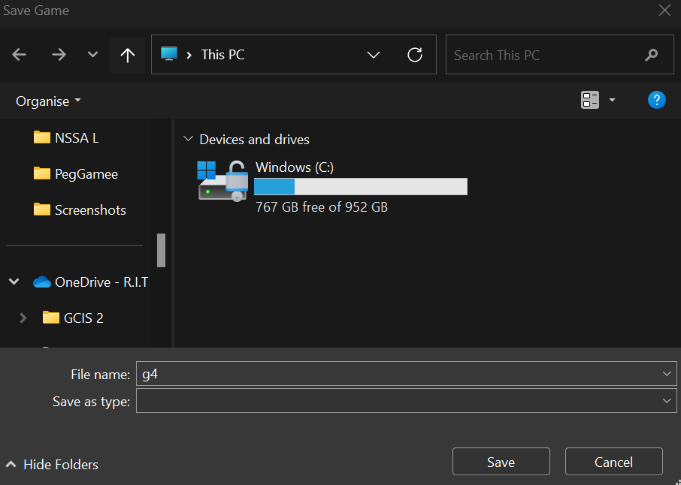
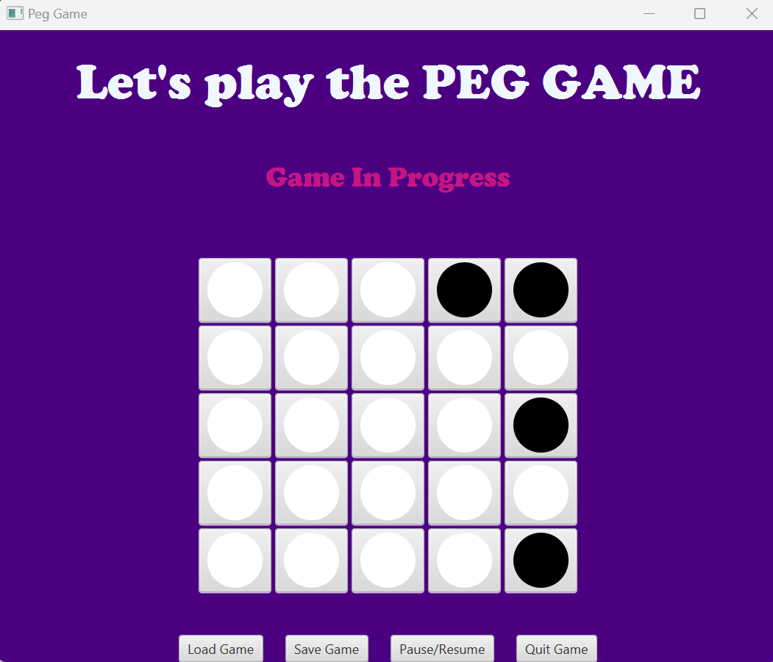
SAVING THE GAME AT ANY POINT OF TIME

Slide 10
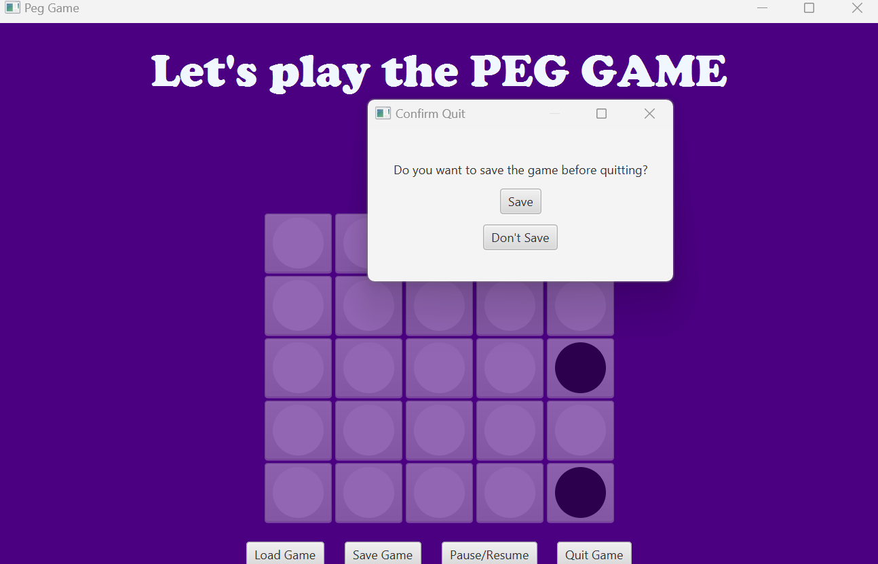
QUITTING AND SAVING THE FILE

Slide 11
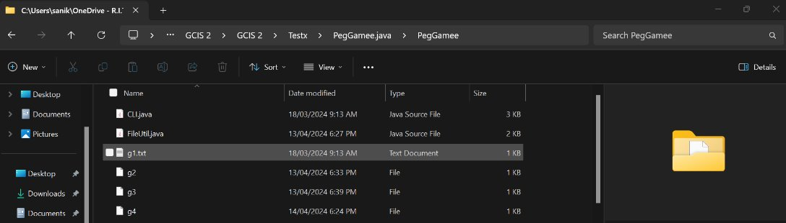
Saved txt file : g4

Slide 12
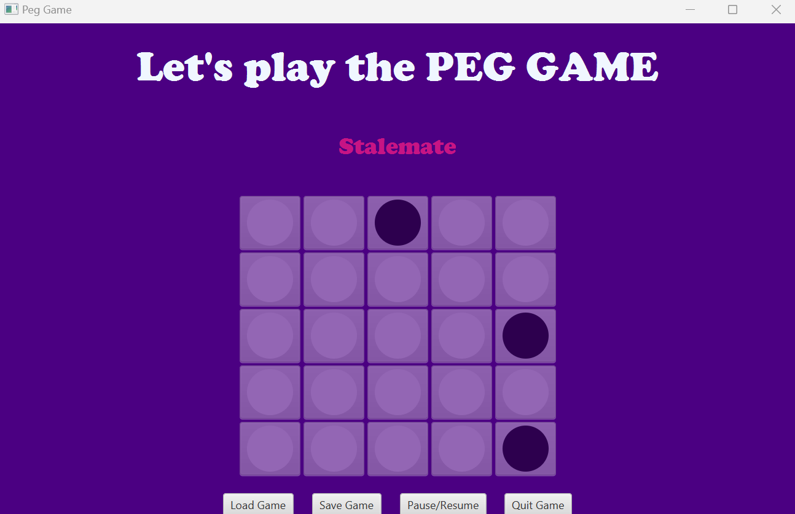
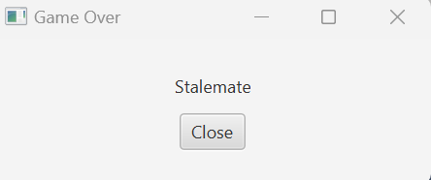
END RESULT – STALEMATE OR WIN

Slide 13
package PegGamee;
import java.util.ArrayList;
import java.util.Arrays;
import java.util.Collection;
import java.util.List;
/**
* Represents a square board in a Peg Game.
*/
public class SqrBoard implements PegGame {
private boolean[][] gameboard; // True if a peg is present, false if it's empty
private GameState gameState;
/**
* Constructs a square board for a Peg Game.
*
* @param board The initial configuration of the board where 'true' represents a peg, and 'false' represents an empty space.
*/
@Test
public SqrBoard(boolean[][] board) {
this.gameboard = board;
this.gameState = GameState.NOT_STARTED;
}
/**
* Gets the current game state based on the number of pegs and possible moves.
*
* @return The current game state.
*/
@Override
@Test
public GameState getGameState() {
int NumofPegs = 0;
for (boolean[] row : gameboard) {
for (boolean peg : row) {
if (peg)
NumofPegs++;
}
}
Collection<Move> possibleMoves = getPossibleMoves();
if (NumofPegs == 1) {
gameState = GameState.WON;
} else if (possibleMoves.isEmpty()) {
gameState = GameState.STALEMATE;
} else {
gameState = GameState.IN_PROGRESS;
}
return gameState;
}
/**
* Checks if a move from one location to another is a valid move.
*
* @param from The starting location of the move.
* @param to The destination location of the move.
* @param midRow The row coordinate of the peg being jumped over.
* @param midCol The column coordinate of the peg being jumped over.
* @return True if the move is valid, false otherwise.
*/
@Test
public boolean isValidMove(Location from, Location to) {
int midRow = (from.getRow() + to.getRow()) / 2;
int midCol = (from.getCol() + to.getCol()) / 2;
// Check bounds
if (from.getRow() < 0 || from.getRow() >= gameboard.length || from.getCol() < 0 || from.getCol() >= gameboard[0].length ||
to.getRow() < 0 || to.getRow() >= gameboard.length || to.getCol() < 0 || to.getCol() >= gameboard[0].length ||
midRow < 0 || midRow >= gameboard.length || midCol < 0 || midCol >= gameboard[0].length) {
return false;
}
// Distance must be exactly two cells in a straight line
boolean isHorizontalMove = from.getRow() == to.getRow() && Math.abs(from.getCol() - to.getCol()) == 2;
boolean isVerticalMove = from.getCol() == to.getCol() && Math.abs(from.getRow() - to.getRow()) == 2;
// Check that 'from' has a peg, 'to' is empty, and 'mid' has a peg
boolean isFromPeg = gameboard[from.getRow()][from.getCol()];
boolean isToEmpty = !gameboard[to.getRow()][to.getCol()];
boolean isMidPeg = gameboard[midRow][midCol];
return (isHorizontalMove || isVerticalMove) && isFromPeg && isToEmpty && isMidPeg;
}
/**
* Adds a valid move to the provided list of moves.
*
* @param fromRow The row coordinate of the starting location.
* @param fromCol The column coordinate of the starting location.
* @param toRow The row coordinate of the destination location.
* @param toCol The column coordinate of the destination location.
* @param movesList The list to which the valid move is added.
*/
@Test
public void AddValidMove(int fromRow, int fromCol, int toRow, int toCol, List<Move> movesList) {
Location from = new Location(fromRow, fromCol);
Location to = new Location(toRow, toCol);
if (isValidMove(from, to)) {
movesList.add(new Move(from, to));
}
}
/**
* Gets a collection of possible moves on the current board.
*
* @return A collection of possible moves.
*/
@Override
@Test
public Collection<Move> getPossibleMoves() {
List<Move> possibleMoves = new ArrayList<>();
for (int row = 0; row < gameboard.length; row++) {
for (int col = 0; col < gameboard[row].length; col++) {
if (gameboard[row][col]) { // If there's a peg at this position
// Check and add valid moves in all directions directly here
AddValidMove(row, col, row, col + 2, possibleMoves); // Right
AddValidMove(row, col, row, col - 2, possibleMoves); // Left
AddValidMove(row, col, row + 2, col, possibleMoves); // Down
AddValidMove(row, col, row - 2, col, possibleMoves); // Up
// Diagonal Moves
AddValidMove(row, col, row - 2, col - 2, possibleMoves); // Diagonal Up-Left
AddValidMove(row, col, row - 2, col + 2, possibleMoves); // Diagonal Up-Right
AddValidMove(row, col, row + 2, col - 2, possibleMoves); // Diagonal Down-Left
AddValidMove(row, col, row + 2, col + 2, possibleMoves); // Diagonal Down-Right
}
}
}
return possibleMoves;
}
/**
* Makes a move on the board based on the provided move object.
*
* @param move The move to be made.
* @throws PegGameException If the move is invalid.
*/
@Override
@Test
public void makeMove(Move move) throws PegGameException {
Location fromLocation = move.getFrom();
Location toLocation = move.getTo();
int midRow = (fromLocation.getRow() + toLocation.getRow()) / 2;
int midCol = (fromLocation.getCol() + toLocation.getCol()) / 2;
if (!isValidMove(fromLocation, toLocation)) {
throw new PegGameException("Invalid move");
}
gameboard[fromLocation.getRow()][fromLocation.getCol()] = false; // Remove the jumping peg
gameboard[midRow][midCol] = false; // Remove the jumped over peg
gameboard[toLocation.getRow()][toLocation.getCol()] = true; // Place the peg in the new location
// Update the game state after the move
getGameState();
}
/**
* Converts the current board state to a string representation.
*
* @return A string representation of the board.
*/
@Override
@Test
public String toString() {
String printboard = "";
for (boolean[] row : gameboard) {
for (boolean isPeg : row) {
printboard += isPeg ? "o " : ". ";
}
printboard += "\n";
}
return printboard;}
public boolean[][] getGameBoard(){
return gameboard;
}
@Override
@Test
public int hashCode() {
final int prime = 31;
int result = 1;
result = prime * result + Arrays.deepHashCode(gameboard);
result = prime * result + ((gameState == null) ? 0 : gameState.hashCode());
return result;
}
@Override
@Test
public boolean equals(Object obj) {
if (this == obj)
return true;
if (obj == null)
return false;
if (getClass() != obj.getClass())
return false;
SqrBoard other = (SqrBoard) obj;
if (!Arrays.deepEquals(gameboard, other.gameboard))
return false;
if (gameState != other.gameState)
return false;
return true;
}
}

Slide 14

Thank You

